Slide 1

GROUP-5
Circular Economy Business Model: Upcycling Plastic
Waste into Eco-Friendly Tiles
SAILESH PANDA - IIB2022028
ABHIRAM CA - IEC2022048
VATSAL BHUVA - IIT2022004
SUGAM SAREEN - IIT2022002
PIYUSH GAUTAM - IFE2022021

Slide 2
The Plastic Waste Crisis: A Growing Problem
Overflowing Landfills Ocean Pollution Limited Recycling Unwanted Plastic
Plastic waste is piling up in landfills, reaching capacity and polluting our environment.
Plastic debris contaminates our oceans, harming marine life and ecosystems.
Traditional recycling methods are inefficient and struggle to cope with the sheer volume of plastic waste.
Plastic packaging, bottles, and other products end up in landfills or discarded inappropriately.

Slide 3
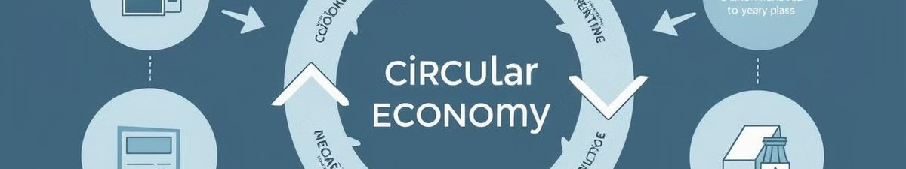
The Circular Economy: A Sustainable Future
Reduce, Reuse, Recycle
The circular economy promotes waste reduction, resource efficiency, and product life extension.
Closed-Loop Systems
It emphasizes the use of materials in closed-loop systems, minimizing waste and pollution.
1
2
3
Upcycling
4
Sustainable Practices
It involves transforming waste into higher-value products, creating new opportunities.
The circular economy encourages sustainable practices to protect our environment for future generations.

Slide 4
Plastic Waste: A Valuable Resource
Durable & Versatile Non-Biodegradable Upcycling Potential
Chosen Waste Streams
Plastic is incredibly durable, making it suitable for numerous applications.
Plastic persists in the environment for hundreds of years, posing environmental risks.
Plastic can be upcycled into new and valuable products, reducing waste and pollution.
We focus on PET (polyethylene terephthalate) and HDPE (high-density polyethylene) for their suitability.

Slide 5
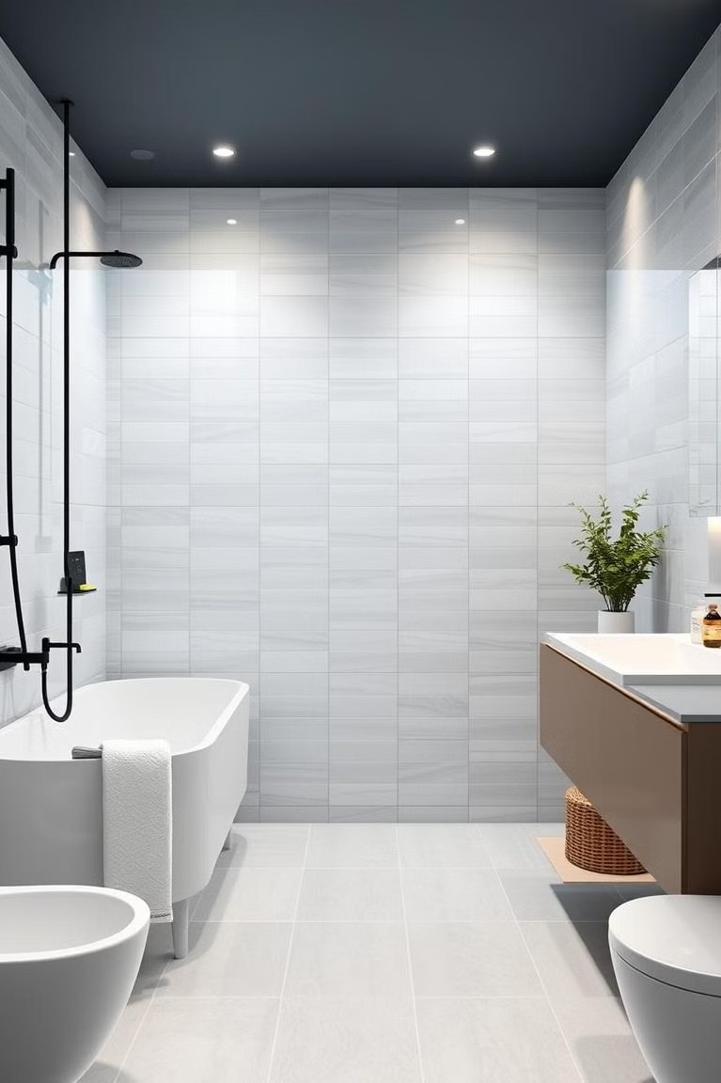
Eco-Friendly Tiles: A Sustainable Solution
Durable & Long-Lasting
Our tiles are made from recycled plastic, offering long- lasting performance.
Eco-Friendly Alternative
They provide a sustainable alternative to traditional tiles, reducing environmental impact.
Versatile Applications
Cost-Effective Choice
Our tiles can be used for flooring, wall cladding, and other interior and exterior applications.
Our upcycled tiles offer competitive pricing, making sustainability accessible.

Slide 6
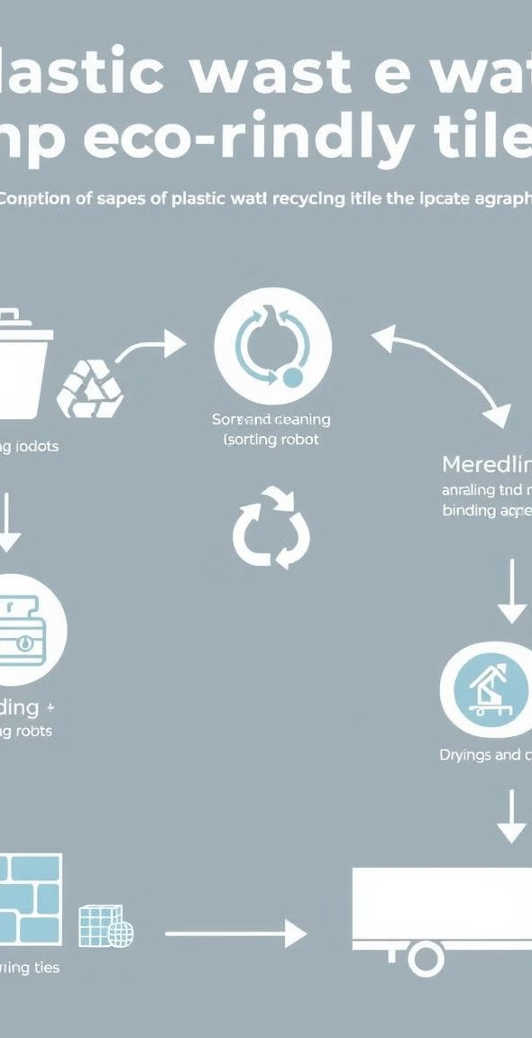
Production Process
Overview: Turning Waste into Tiles
Collection
We partner with local waste collectors to gather plastic waste from various sources.
1
Sorting & Cleaning
Plastic waste is sorted and cleaned, removing contaminants and preparing it for processing.
2
3
Shredding & Melting
Plastic is shredded into small pieces and melted into a uniform molten material.
Molding & Finishing
The molten plastic is molded into tiles and undergoes finishing processes for quality assurance.
4

Slide 7
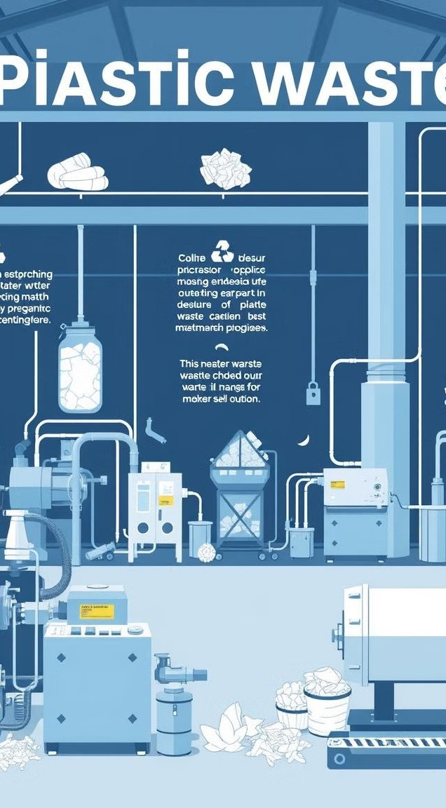
Detailed Production Process: Step-by-Step
Collection
We source plastic waste from households, businesses, and recycling facilities.
1
Sorting & Cleaning
Our team carefully sorts and cleans the plastic waste, separating different types and removing impurities.
2
Shredding & Melting
Shredders break down plastic into smaller pieces, and melting machines turn them into a uniform liquid.
3
Molding & Finishing
Molten plastic is poured into molds to create tiles, and finishing processes ensure quality and durability.
4

Slide 8
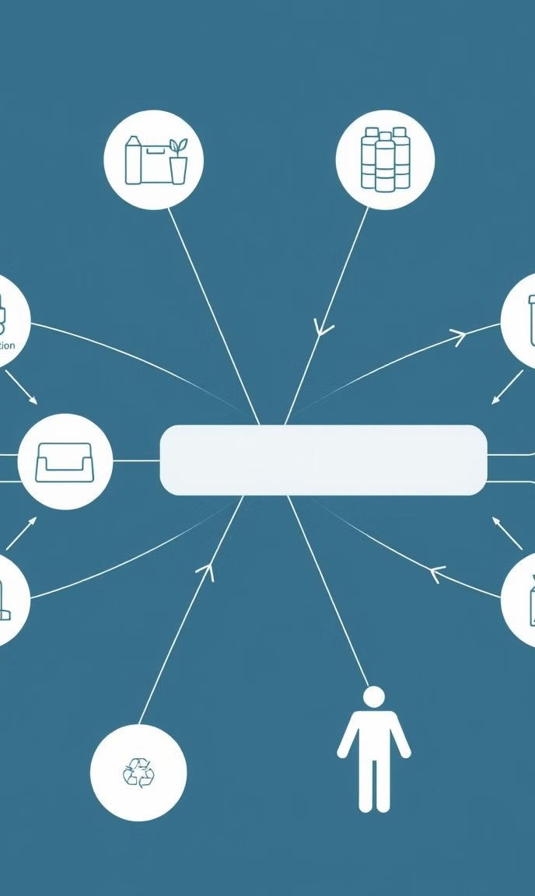
Partnerships &
Collaborations: Building a Sustainable Network
Waste Collectors
We partner with local waste collectors to ensure consistent supply of plastic waste.
Recycling Centers
Collaboration with recycling centers enables efficient sorting and preparation of plastic waste.
Construction Companies
Partnerships with construction companies expand the reach and market for our eco-friendly tiles.
Local Communities
Engaging with communities raises awareness and promotes sustainable waste management practices.

Slide 9
Business Model Canvas: A Framework for Success
Value Proposition
1
Eco-friendly, durable, and cost-effective tiles made from upcycled plastic waste.
Customer Segments
Construction companies, homeowners, and businesses seeking sustainable building materials.
2
Revenue Streams
Sales of eco-friendly tiles, potential partnerships with retailers and distributors.
3
Cost Structure
4
Production costs, marketing and distribution expenses, waste collection and processing fees.

Slide 10
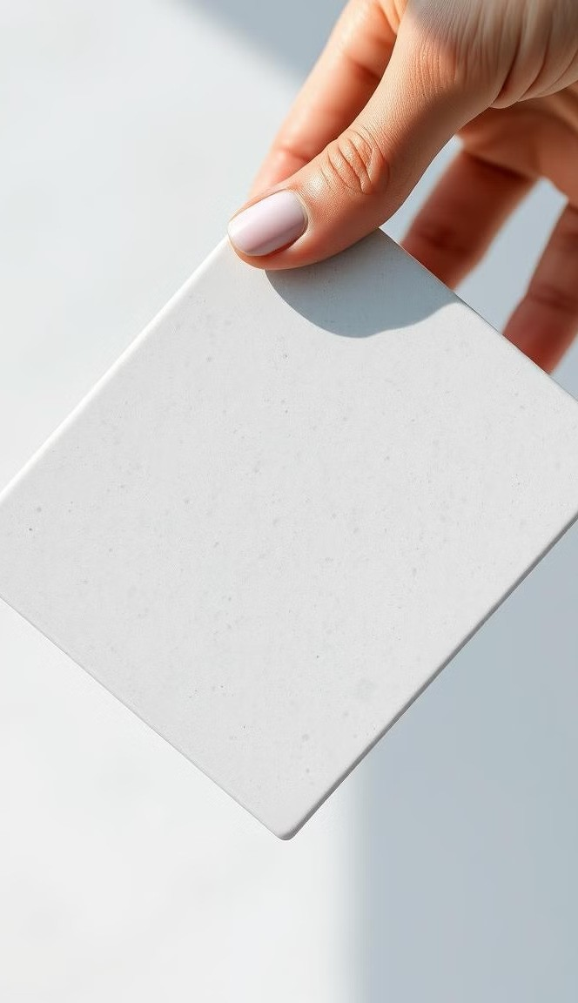
Value Proposition: A Sustainable and Competitive Advantage
1
Eco-Friendly
Reduces plastic waste and contributes to a greener environment.
2
Durable
Made from high-quality recycled plastic, ensuring long-lasting performance.
3
Cost-Effective
4
Innovative
Offers competitive pricing compared to traditional tiles, making
sustainability accessible.
Pioneering a circular economy approach to waste management and tile production.

Slide 11
Market Validation and Demand
Construction Industry Feedback
Our surveys with construction firms revealed a significant demand for eco-friendly building materials, especially those made from recycled materials.
Homeowner Preferences
Research shows that homeowners are increasingly prioritizing sustainable building practices, leading to a growing market for eco-conscious materials.

Slide 12

Prototype Showcase
1
Recycled Plastic Inno ation
These eco-tiles are crafted from a proprietary blend of recycled plastics, ensuring a durable and environmentally conscious product.
2
Aesthetic Versatility
Our eco-tiles are available in a range of colors, textures, and finishes to meet diverse design preferences.

Slide 13
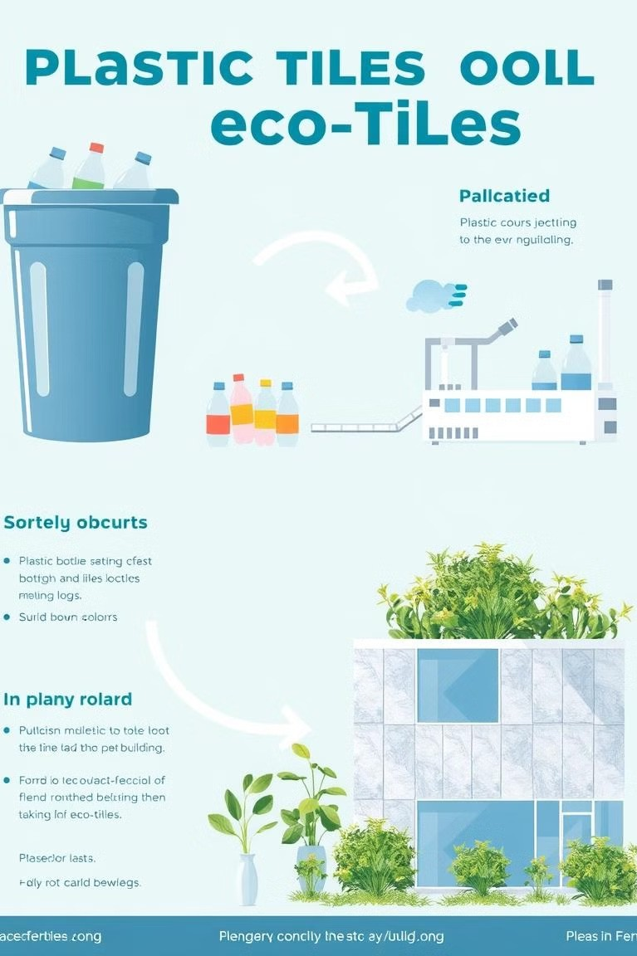
Sustainability Strategy
Reducing Plastic Waste Our process significantly reduces plastic waste from landfills and promotes a circular economy approach.
Closed-Loop Recycling We actively source plastic waste from local communities and collaborate with waste management companies to ensure responsible sourcing.
En ironmentally Conscious Production
Our manufacturing process is designed to minimize energy consumption and emissions, promoting a sustainable production model.

Slide 14

Scalability and Growth
Expanded Waste Sourcing
We plan to expand our waste sourcing network to encompass a wider range of plastic types and increase our production capacity.
Di ersified Product Range We are developing new eco-tile products with varying sizes, shapes,
and functionalities to cater to a wider market.
Replicating the Model
We aim to replicate our business model in other communities, contributing to local waste management solutions and job creation.

Slide 15
Call to Action
In est in Sustainability
Join us in building a more sustainable future.
1
Partner for Impact
Collaborate to bring this innovative solution to market.
2
Community Engagement
Get involved in supporting local waste reduction efforts.
3

